Slide 1
The objective identification of warm sector rainfall in North China
Jiaolan Fu and FuqinG Zhang
May 23 2018

Slide 2
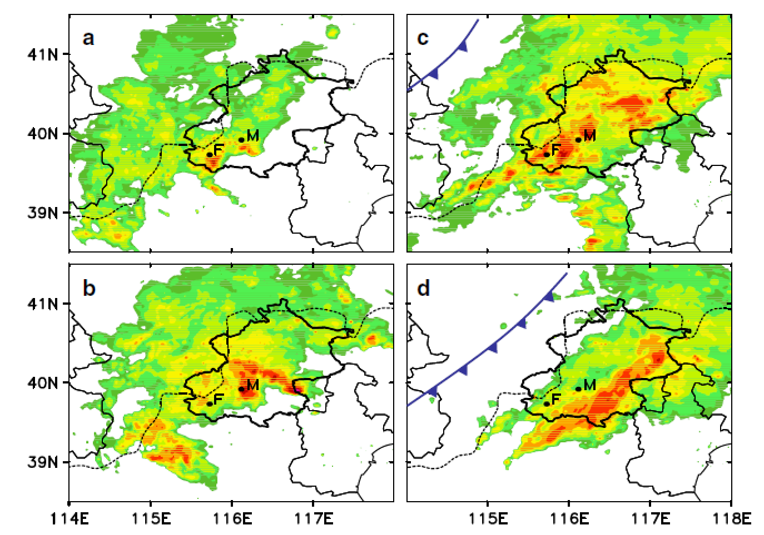
Warm sector rainfall in North china
Zhang DL, 2013, GRL

Slide 3
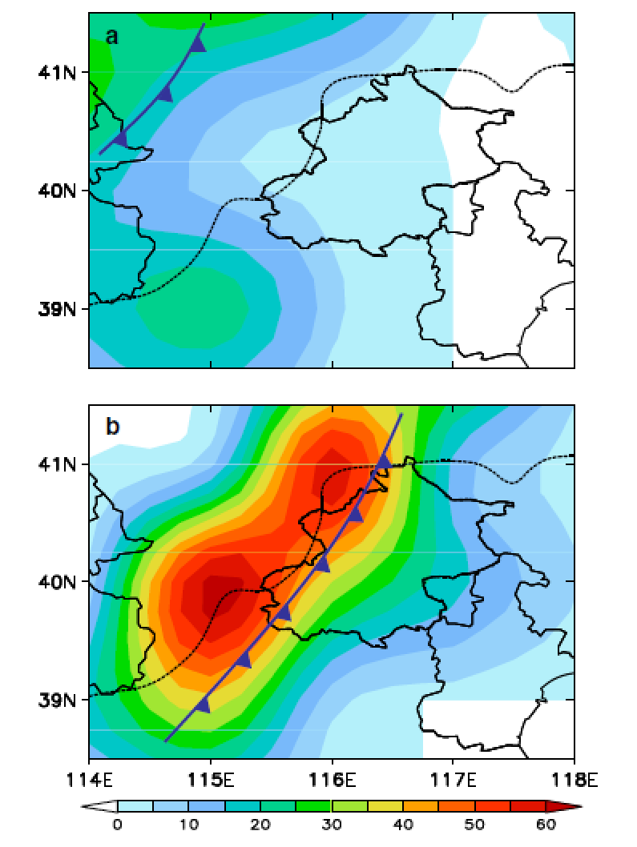
Model forecast of the warm sector rainfall
Zhang DL, 2013, GRL

Slide 4
Topics about warm sector rainfall
Definition of warm sector rainfall in north china
Climatic feature of warm sector rainfall, such as the rainfall and MCS characteristics, the background circulation and its environmental conditions or convective environment
Figure out How the operational model capacity to forecast these warm sector cases

Slide 5
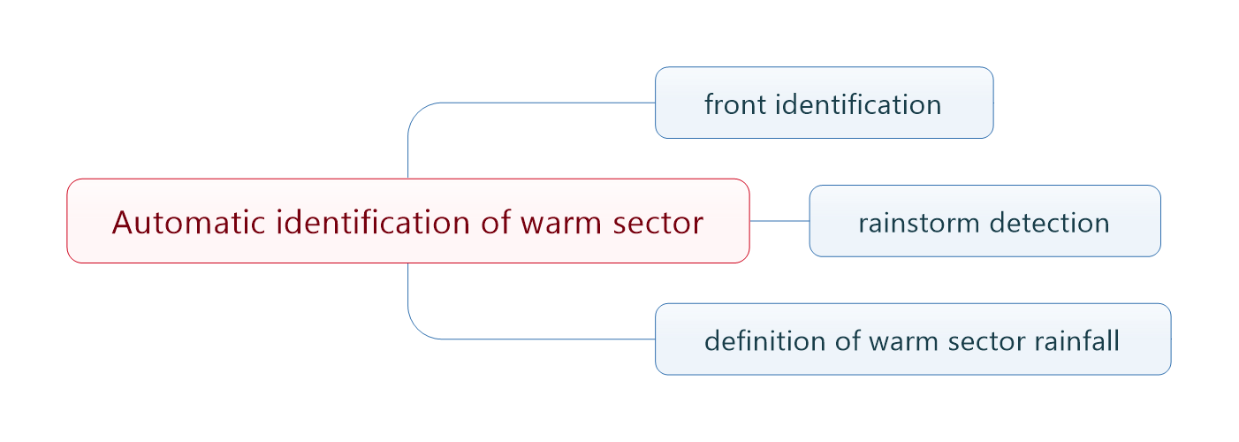
Warm sector rainfall detection scheme

Slide 6
Data
Circulation data: ECMWF interim data, resolution: 0.75, time interval: 6h, during 2012-2017,May to September
1h Automatic weather station (AWS) rainfall data, gridded by kriging at 0.02 spatial resolution

Slide 7
Method of Identification of synoptic front
The thermal parameter: equivalent potential temperature
Intensity of front :
Thermal front parameter: $TFP=−∇\left|∇EPT\right|∙\frac{∇EPT}{\left|∇EPT\right|}=0$
Tuting: $∇∙∇\left|∇EPT\right|<0$
Front type:$vf=\overset{→}{V}∙\frac{∇TFP}{\left|∇TFP\right|}$
Synoptic front: >1000km
$$∇EPT>6K/100km$$
Hewson, 1998, Meteorol. Appl.
Jenkner, et al., 2010, Meteorol. Appl.

Slide 8
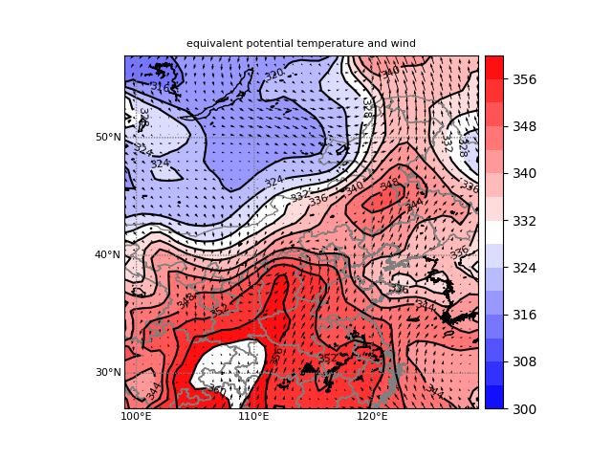
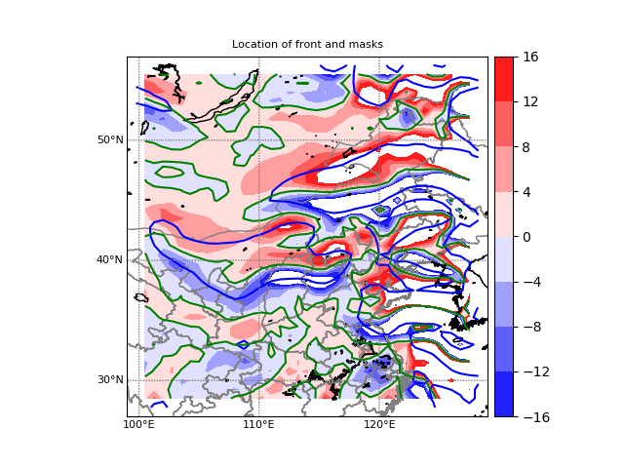
Jul. 1 08:00 2012 Equivalent potential temperature and wind
Gradient of Equivalent potential temperature (blue)
TFP (shaded, green: TFP=0)

Slide 9
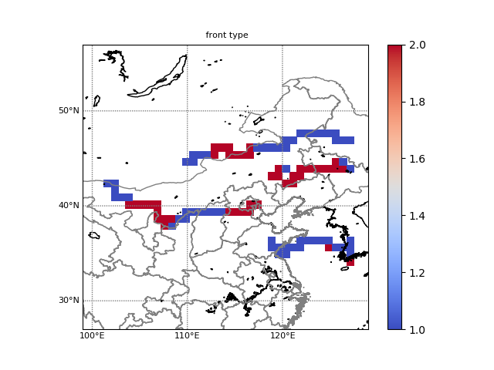
LOCATION OF SYNOPTIC FRONT
FRONT TYPE, BLUE (COLD), RED(WARM)

Slide 10
Automatic Detection of rainstorm cluster
continuous rainfall area >5mm/1H
RAIN >10mm rainfall storm Size >100*100km
Maximum rainfall >30mm

Slide 11
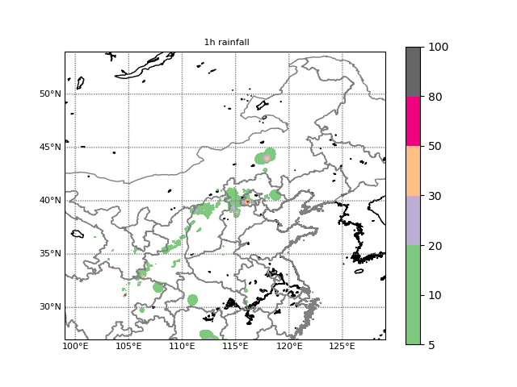
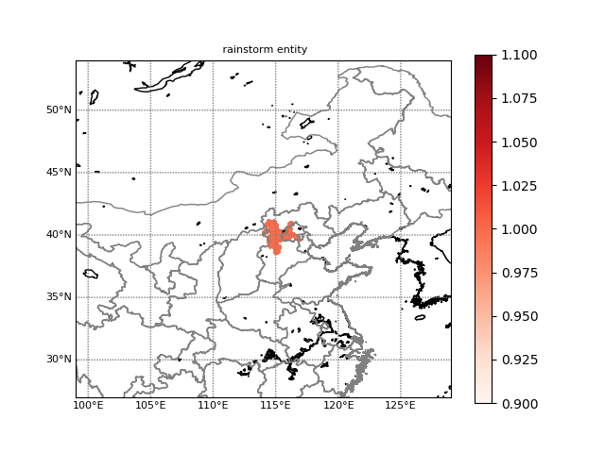
Jul. 21 14:00 2012 1h rainfall
The detected rainstorm entity

Slide 12
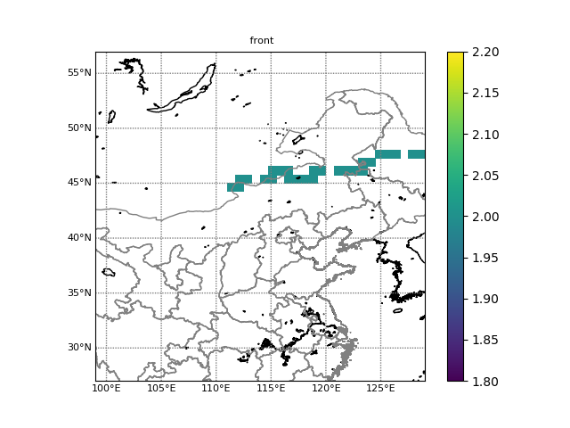
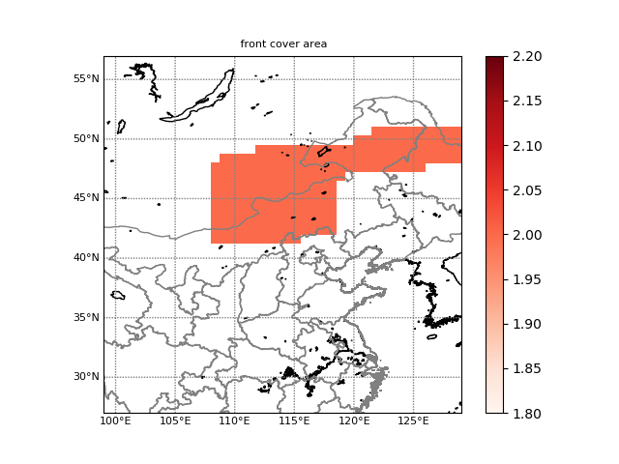
The definition of warm sector rainfall
Huang (1988) consider rainstorm 200km ahead of cold front over south china
NOAA National weather service glossary
A region of warm surface air between a cold front and a warm front.
covering area of the front (200km pre-frtont and post-front)
Warm sector rainfall: Mass center or centroid of rainstorm will be outside of covering area of front

Slide 13
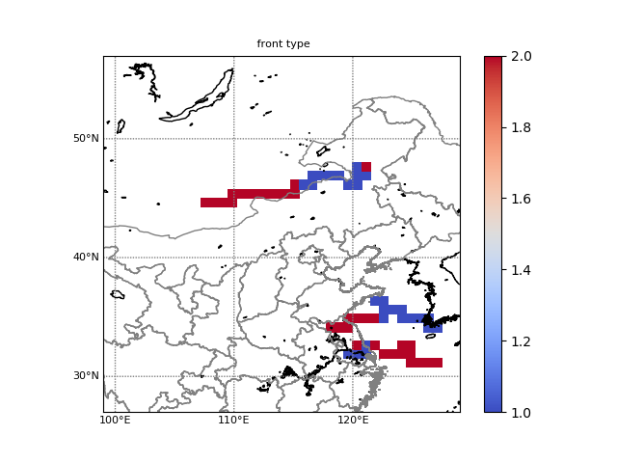
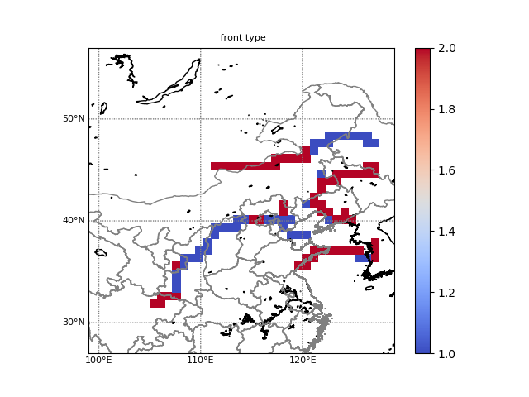
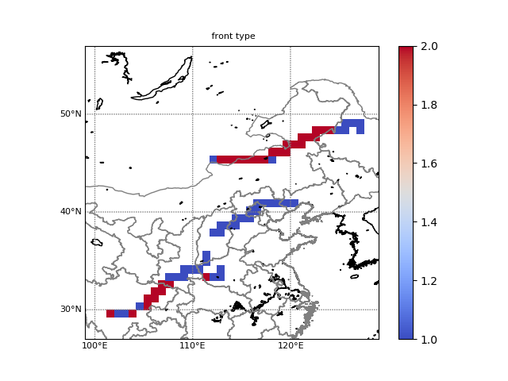
Jul. 21 08:00LST
Jul. 21 14:00LST
Jul. 21 20:00LST
Jul. 22 02:00LST

Slide 14
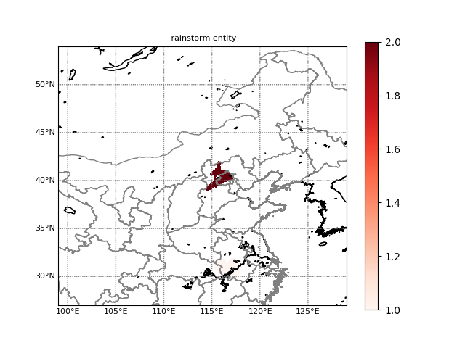
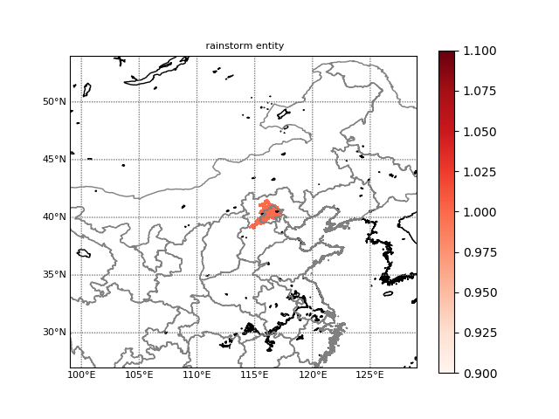
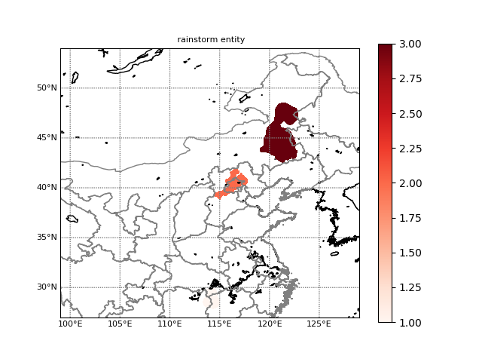
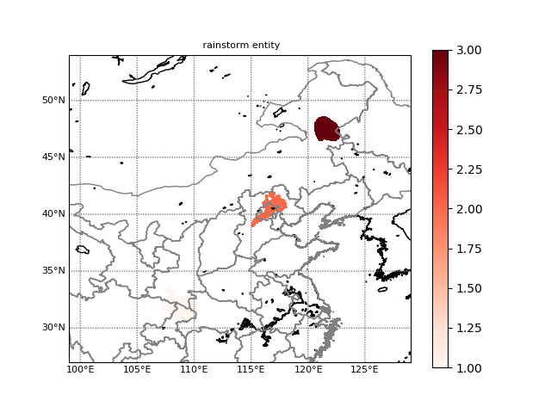

Slide 15
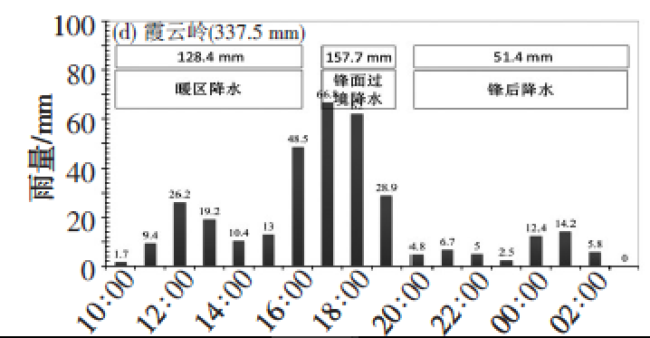
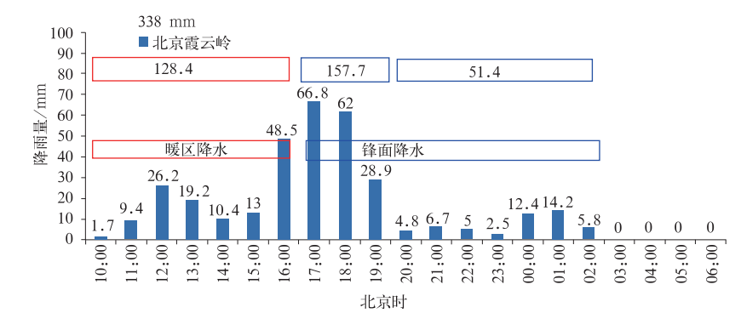
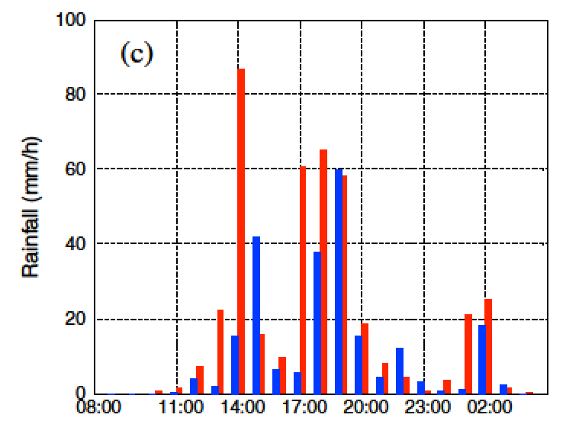
Duan et al. 2017, Torrential Rain and Disasters
Chen et al. 2012, Meteorological Monthly
21 20:00：pre-front rainfall
21 21::00-22 06:00 front rainfall
Sun et al.,2013, Chinese Journal of Atmospheric Sciences
21 13:00-14:00 Typical warm sector rainfall
21 16:00-19:00 rainfall related with Low level vortex
21 20:00 front rainfall
warm sector rainfall: 13:00-14:00
Warm front rainfall:14:00-20:00
Cold front rainfall: after 20:00
Zhong et al. 2015, JGR

Slide 16
Discussion and Future work
Front location parameter is located at the maximum gradient of EPT, not shifted to warm side of airmass, which may influence the warm sector rainfall identification a lit bit
To avoid the topography’s effect, front at 850hPa is identified. other level’s front at low level troposphere should be detect as well.
The climatic characteristics of warm sector rainfall in North China
Evaluation of the performance of operational model guidance or the model’s predictability on warm sector rainfall

